Slide 1
CrowdFunding
Presented by :
Crowdfunding Platform powered by Blockchain
Ajay Singh Dhillon (20196303119)
Himanshu Mittal (20796303119)
Gaurav Raghav (20896303119)
Guided by :
Dr. Tripti Rathee

Slide 2
Table of contents
01.
Introduction
03.
Technical Analysis
02.
Proposed Solution
04.
Prototype Presentation
Problem Statement and Necessity.
Feasibility
UML Diagram
Tech Stack
Identifying Stakeholders
Detailed Solution
Presenting the Final Prototype
Conclusion

Slide 3
01.
Introduction
Problem Statement and Necessity.
Feasibility

Slide 4
Introduction
Crowdfunding is one of the most popular ways to raise funds for any project, cause or for helping any individual in need. With the onset of Covid we have seen a rise in Crowdfunding activities across the globe which includes small campaigns to help people get oxygen and medical help to large funds such as PM Cares.

Slide 5
Major Problems
Security
Transparency &
Anti-Fraud
Global Contribution

Slide 6
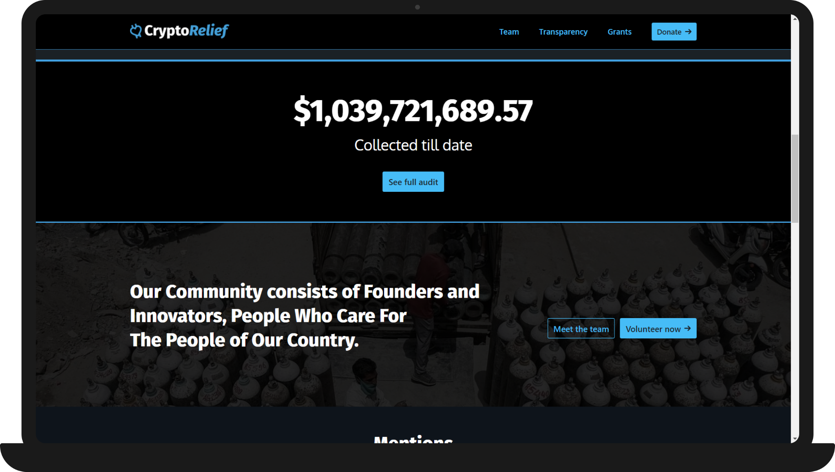
We were highly inspired by the Indian Crypto Community ( www.cryptorelief.in ) which raised
~1 billion dollars for Covid Relief in India and how transparent they were during the entire process.

Slide 7
Feasibility: Technical & Non-Technical
Technical
It is to be a ReactJS based application, which will be supported by any web browser.
Internet connectivity will be required.
Users will require ‘Metamask’ browser extension to sign transactions.
Social
Crowdfunding over the years has helped people but has also seen heavy frauds in the name of Crowdfunding. With Betterfund we want to bring transparency to the process of crowdfunding and build trust among people to contribute to all the causes.

Slide 8
Feasibility: Technical & Non-Technical
Economic
Given the Ethereum Blockchain provides us with most of the security features, the development does not require much cost.
The only cost would be the server cost of the deployed application.
Scope
With CrowdFunding App we aim to make the crowdfunding process transparent, anti-fraudulent and secure.

Slide 9
02.
Proposed
Solution
Identifying Stakeholders
Detailed Solution

Slide 10
Identifying stakeholders
The stakeholders can be divided into two parts:
Campaign Creators : These are the users who have created a Campaign.
Contributors : Contributors are the users who contribute more than the Minimum Contribution and fund the campaigns.

Slide 11
Detailed Solution
Any web based application is a centralized application which means that anything we do on the platform is managed by a server which is owned by a single company.
We propose a Decentralized Application powered by Ethereum Blockchain, where all the information about campaigns, contributions, withdrawal and funds are kept on a Blockchain Network, visible to all and decentralized. This means the funds and transactions are visible to and stored at every node on the blockchain, and prevents the data from being stored in a centralized server, single location.
Hence not letting the money get into the hands of anyone and eliminating every possibility of it getting misused — an elegant and logical solution to the problem in hand.

Slide 12
Following are the proposed features

Slide 13
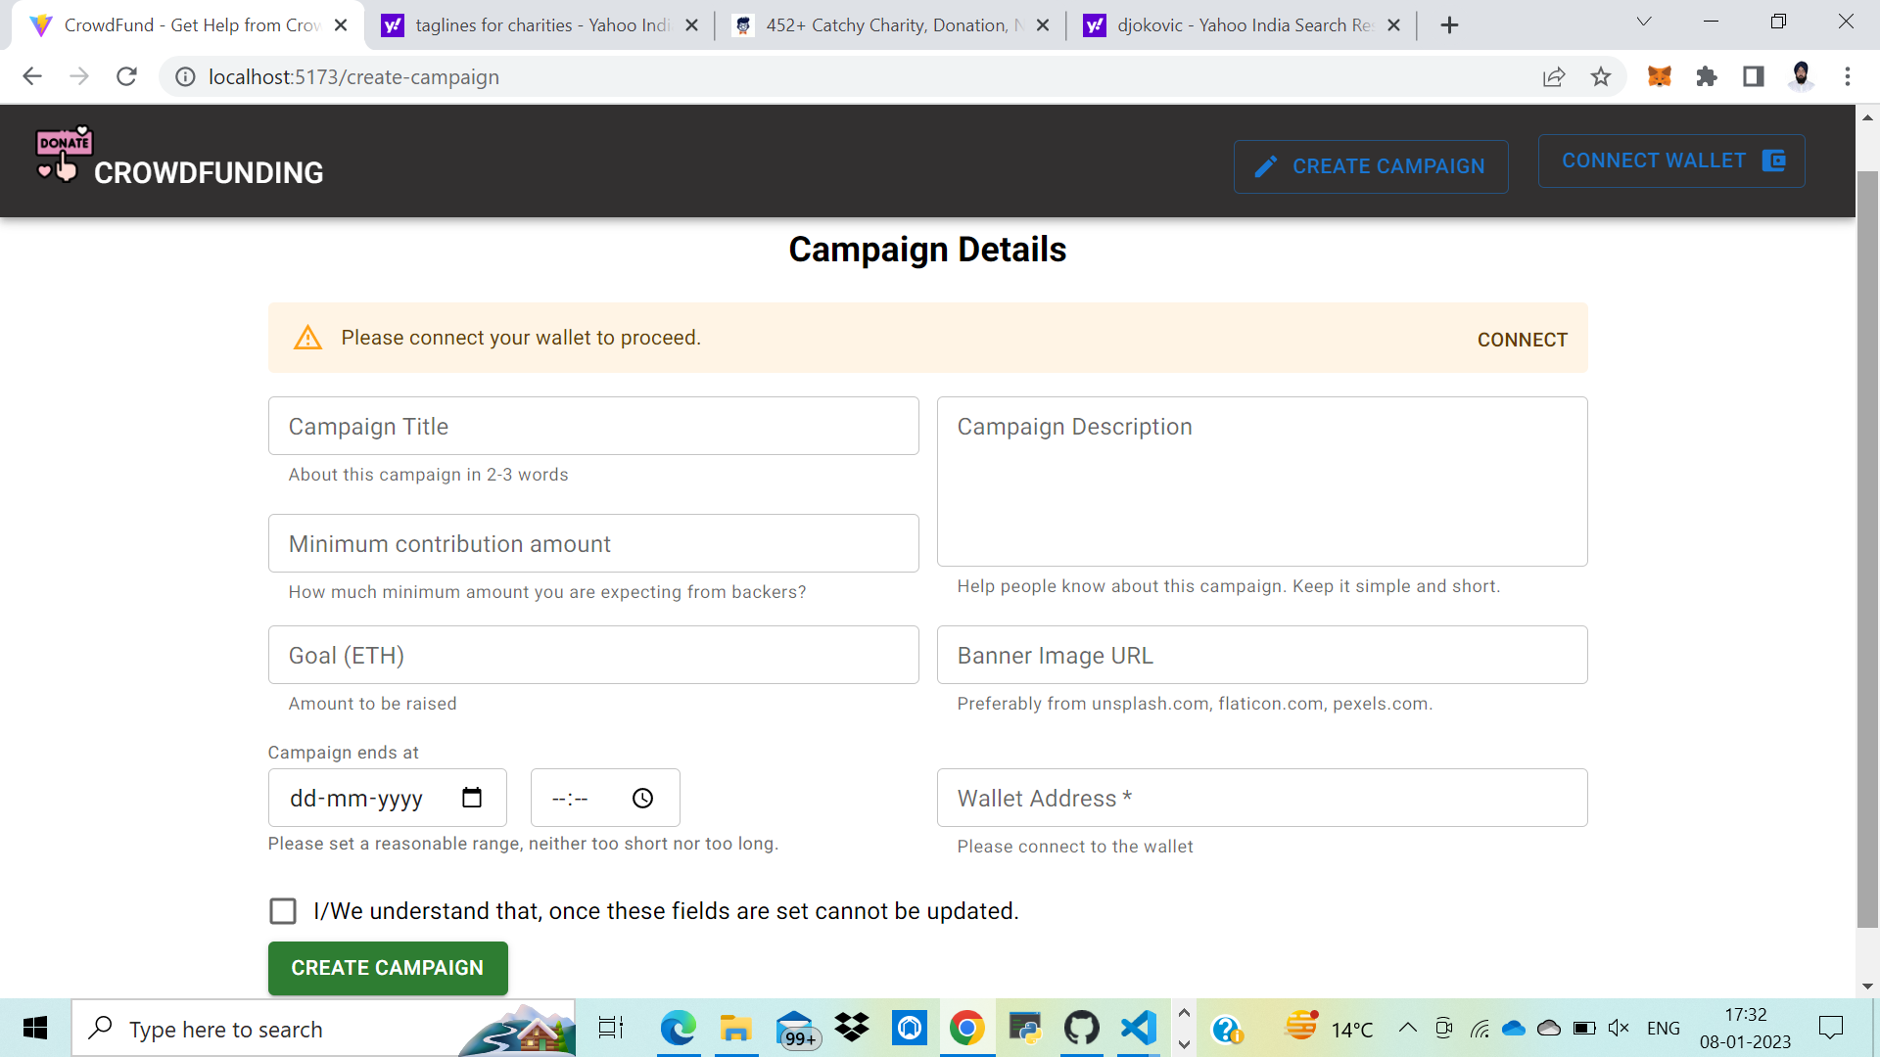
Feature-1
Creating Campaign
Just like Crowdfunding in the real world as well as on other crowdfunding platforms, anyone can create a campaign in a few minutes. The campaign information will be managed by the Ethereum-based smart contract and thus cannot be tampered with.

Slide 14
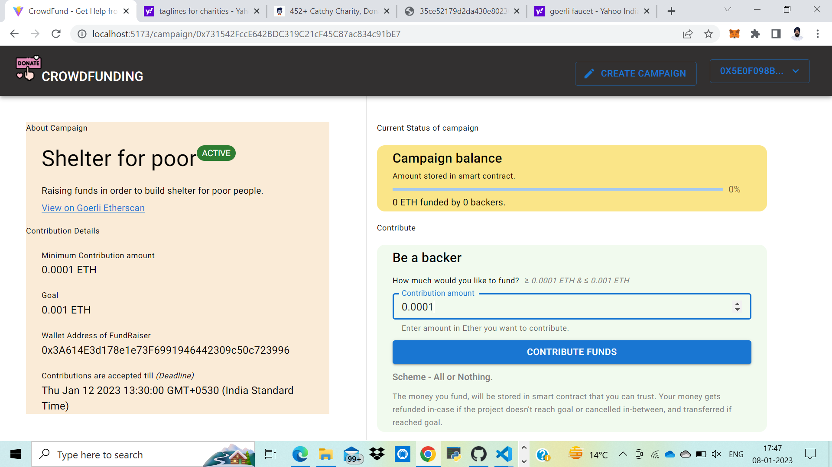
Feature-2
Contributing to a Campaign
Once a campaign has been created, users can share the campaign and anybody can contribute to the campaign. The funds will go to the address of the campaign and not to the creator of the campaign, thus making the process more efficient and anti-fraudulent.

Slide 15
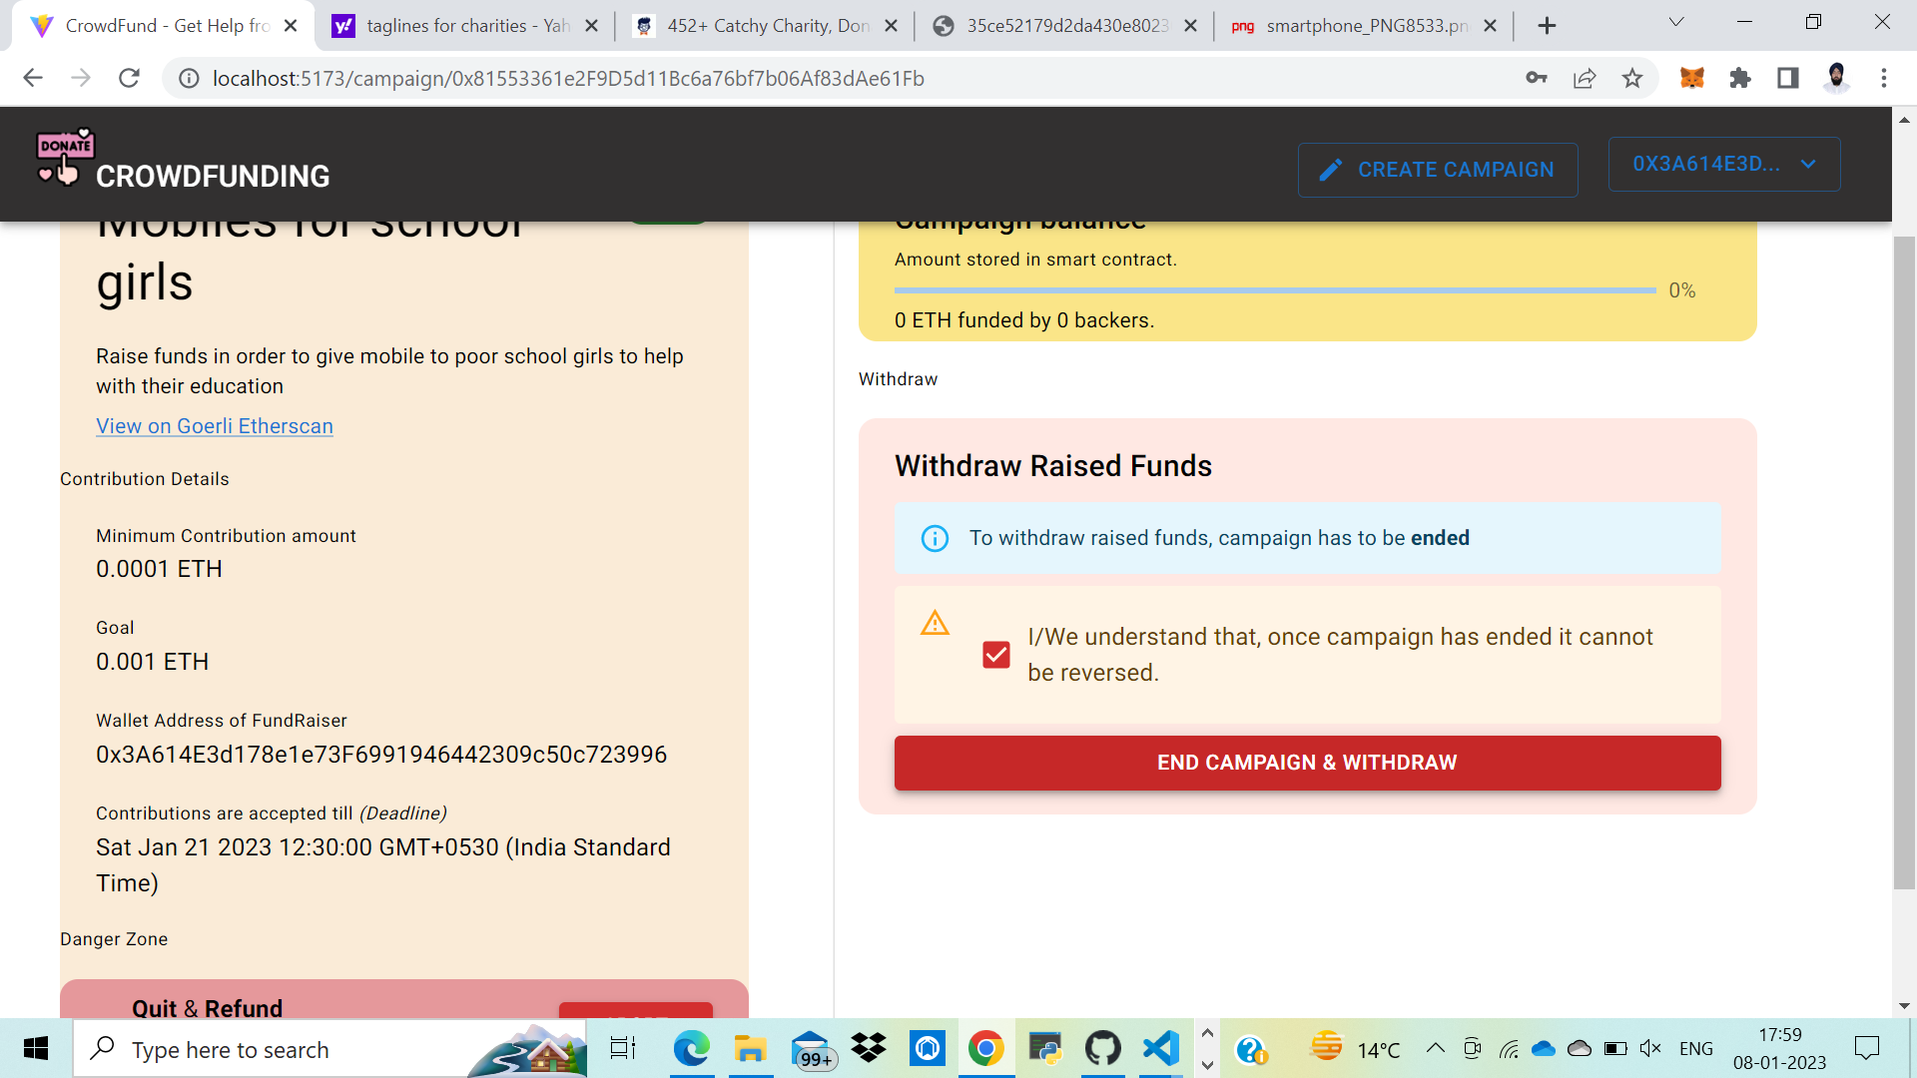
Feature-3
Withdrawal of Funds
The Creator of a Campaign can propose how to use the funds in the form of a Withdrawal Request. Anybody who contributes more than a particular amount is called an approver, and will be able to approve or deny the request.
Funds can’t be withdrawn without the approval of 50% approvers.

Slide 16
03.
Technical Analysis
UML Diagram
Tech Stack

Slide 17
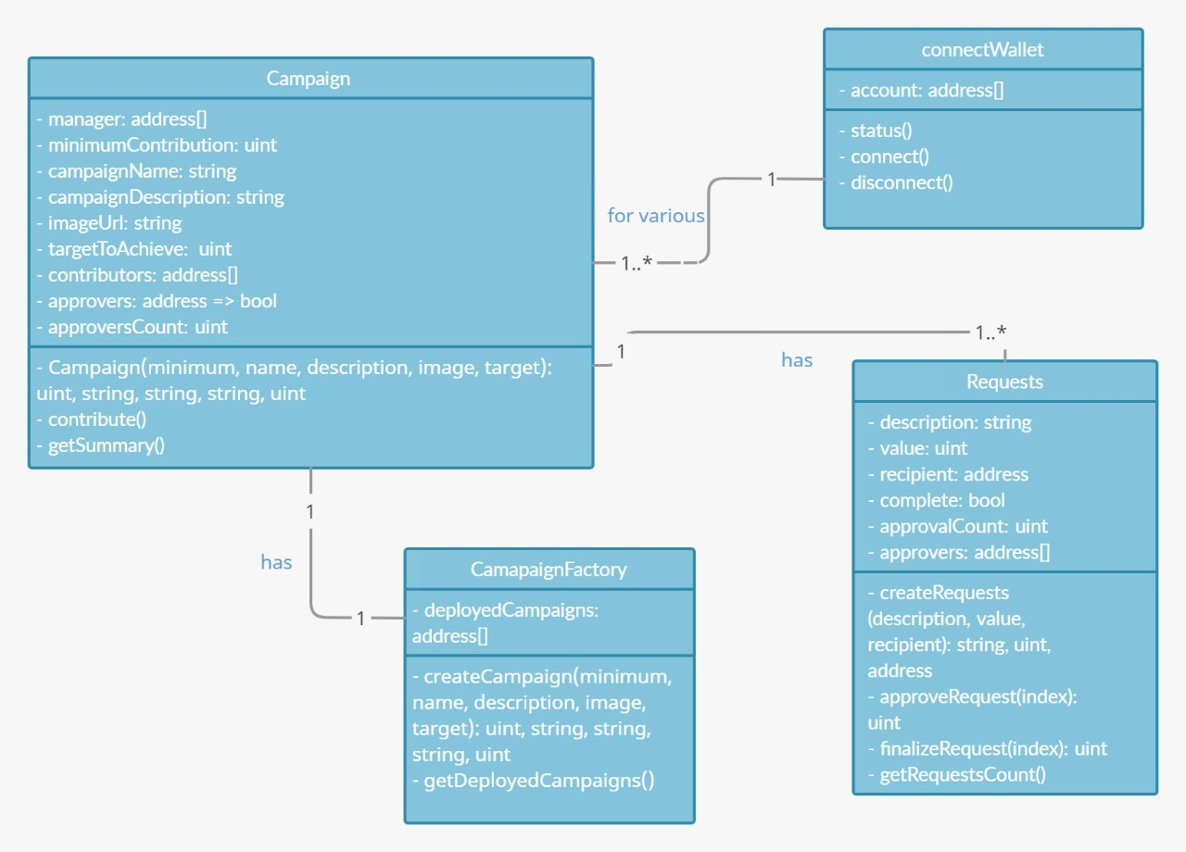
UML Diagram
Class Diagram
The Classes defined are:
Campaign
CampaignFactory
Requests
connectWallet
The Relationships defined are:
A User connects his wallet to support various campaigns; one to many.
A campaignFactory has its Campaign; one to one.
A Campaign has multiple Requests; one to many.

Slide 18
Tech Stack Analysis
Optimized
For
speed
Efficient
Secure
In order to achieve the solution we have chosen a tech stack that is

Slide 19
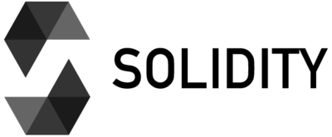
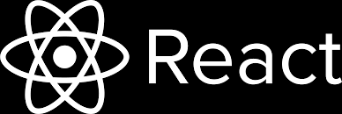

Tech Stack Analysis
The Technologies that have been used are :
React
React makes it painless to create interactive UIs. Design simple views for each state in your application, and React will efficiently update and render just the right components when your data changes.
MUI
MUI offers a comprehensive suite of UI tools to help you ship new features faster. Start with Material UI, our fully-loaded component library, or bring your own design system to our production-ready components..
Solidity
It is the programming language for implementing Ethereum based Smart Contracts.

Slide 20
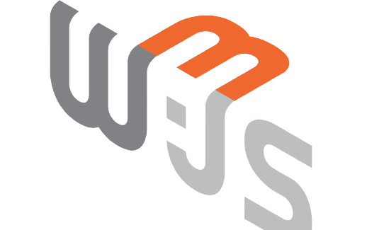
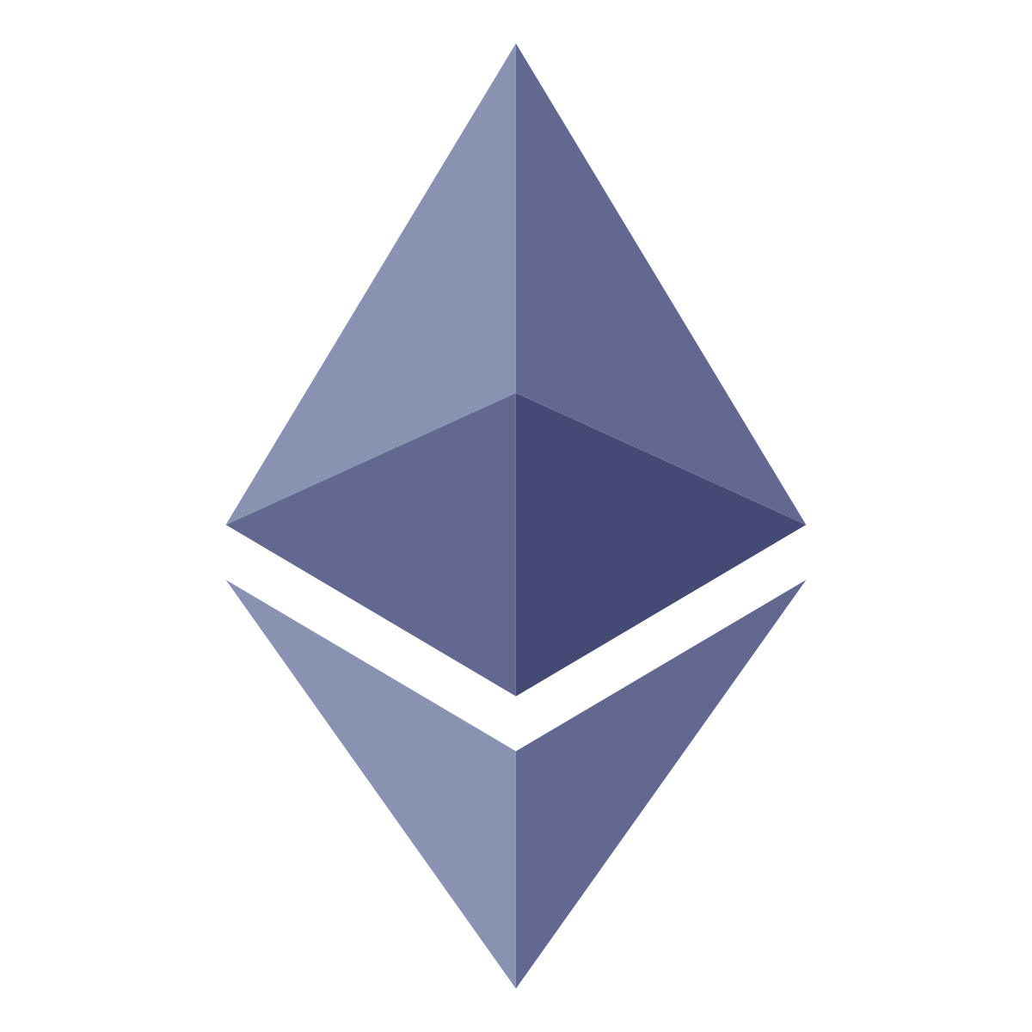
Tech Stack Analysis
The Technologies that have been used are :
Web3
web3.js is a collection of libraries that allow you to interact with a local or remote ethereum node.
Ethereum Smart Contract
It is the collection of functions and data that reside at a specific address on the Ethereum Blockchain.

Slide 21
04.
Prototype Presentation
Presenting the Final Prototype
Conclusion

Slide 22
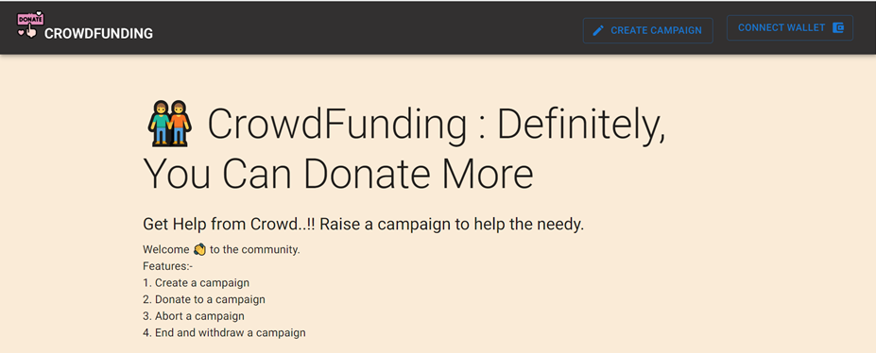
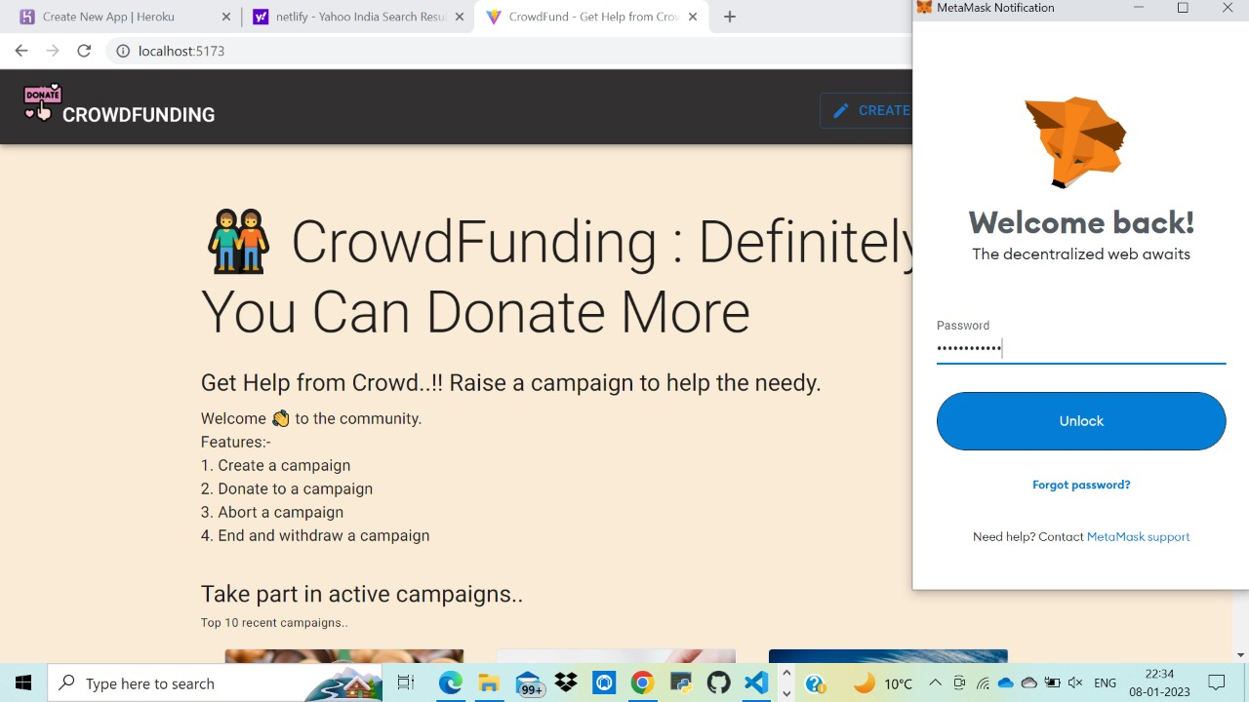
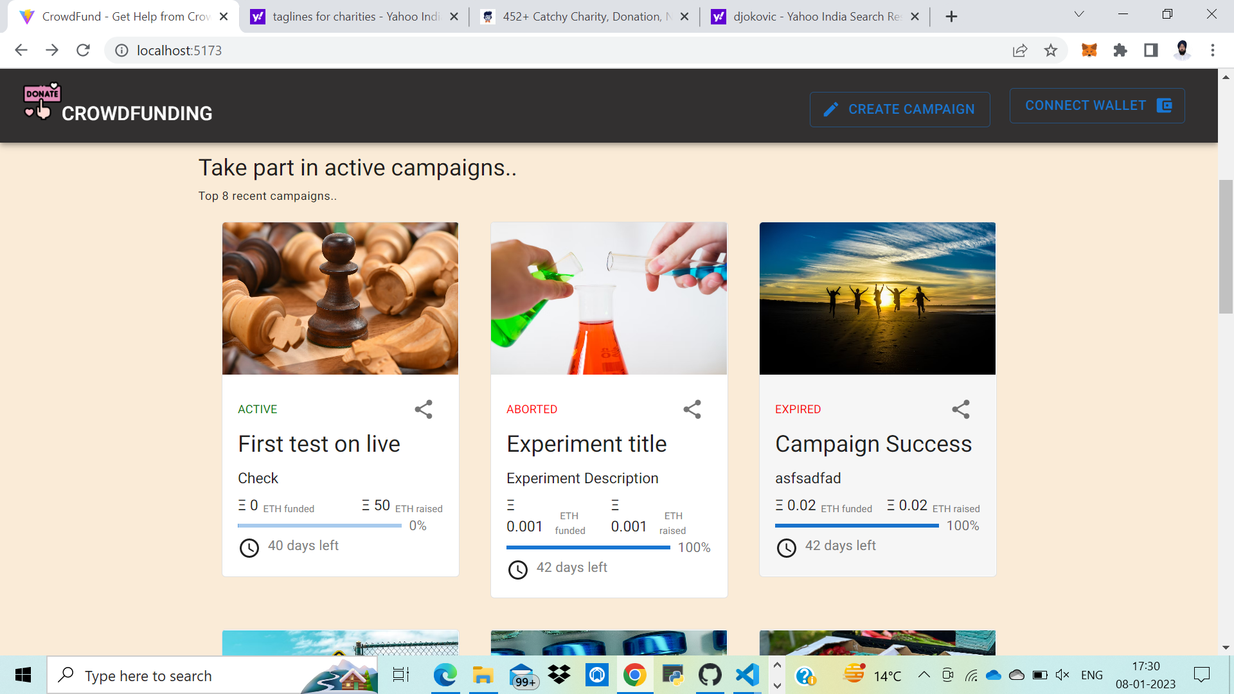
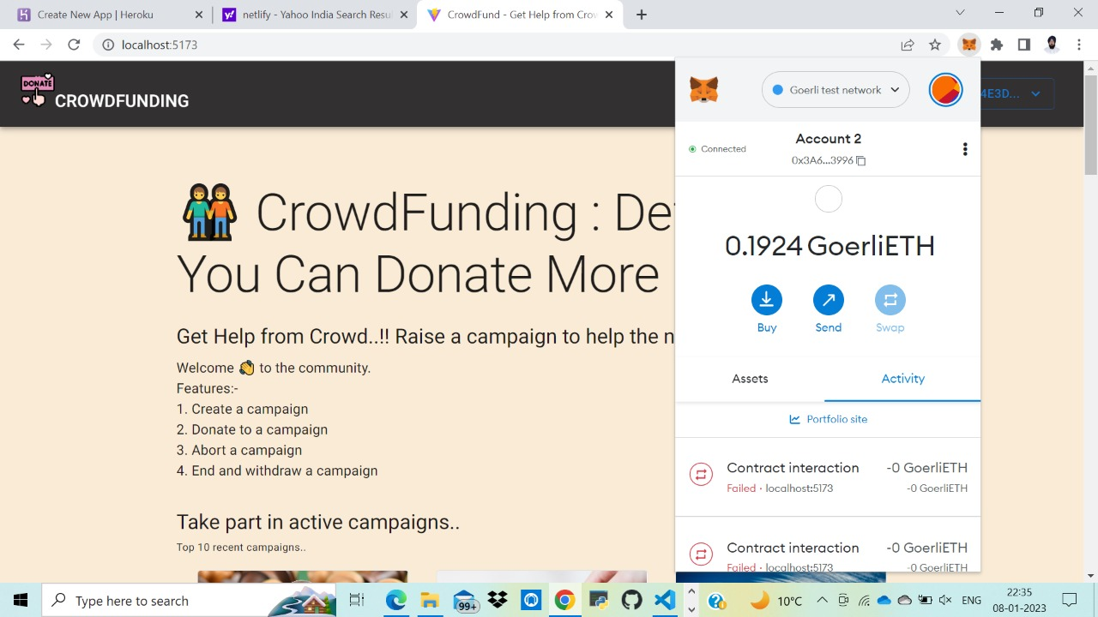
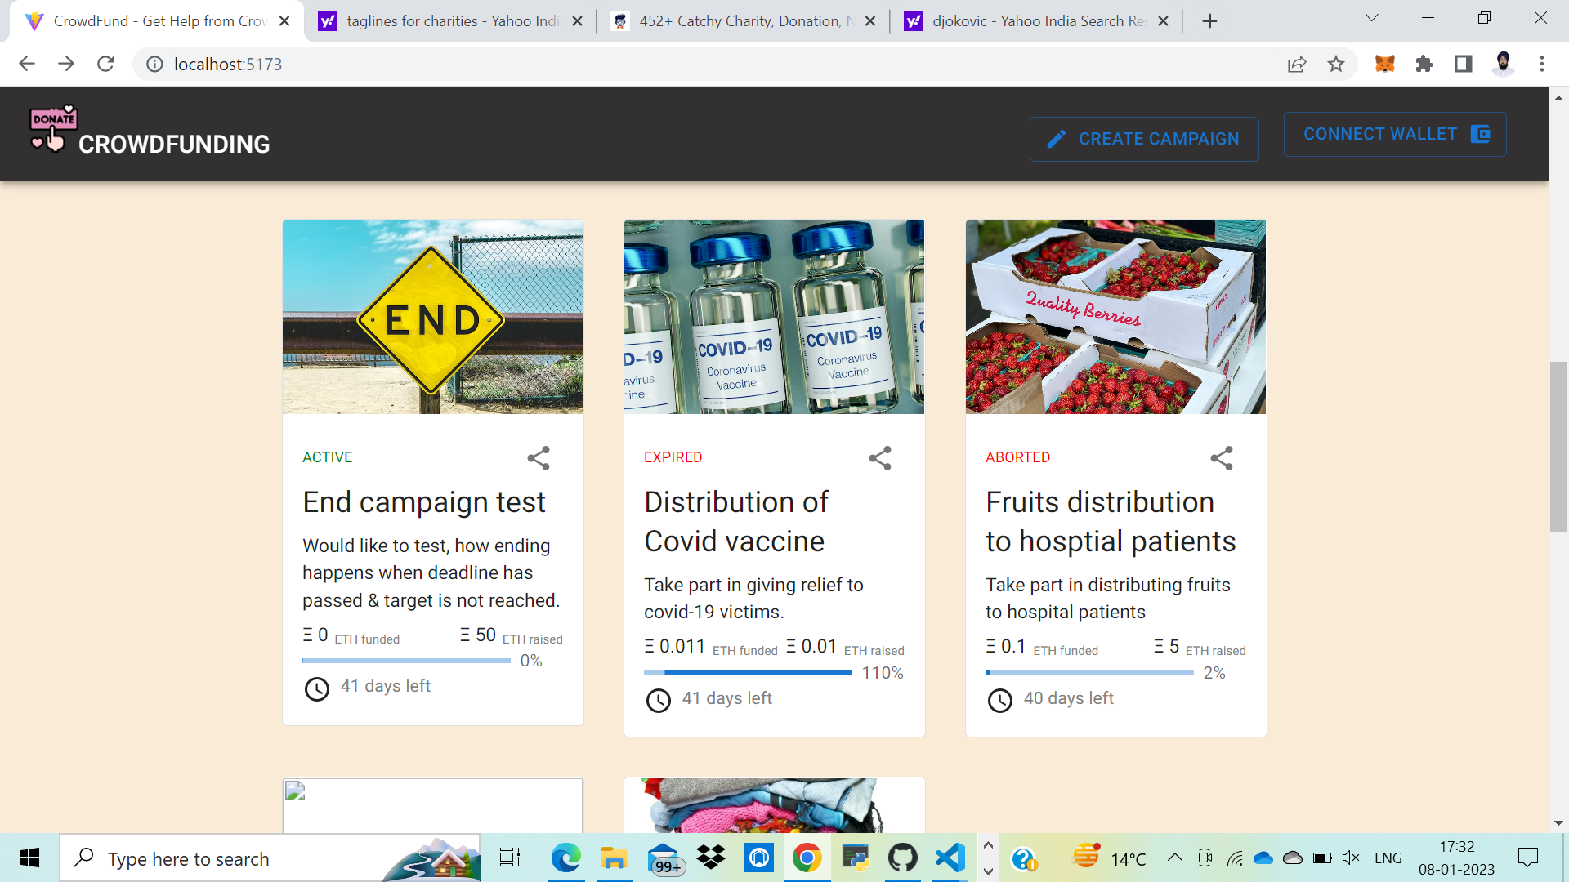
Connect Wallet

Slide 23
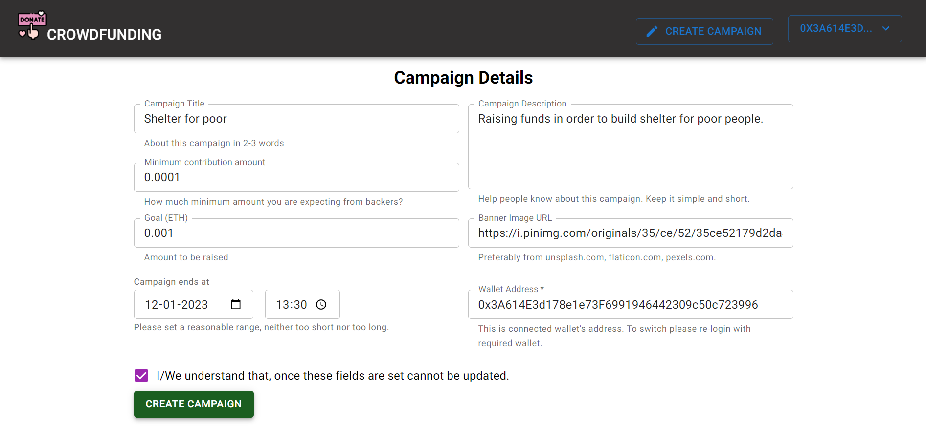
Creating a Campaign

Slide 24
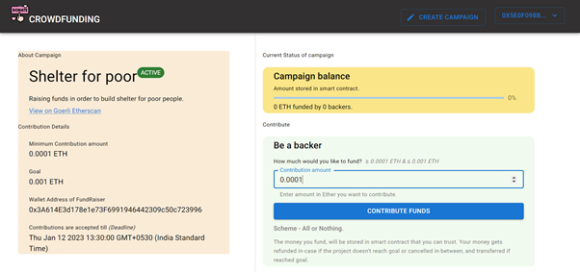
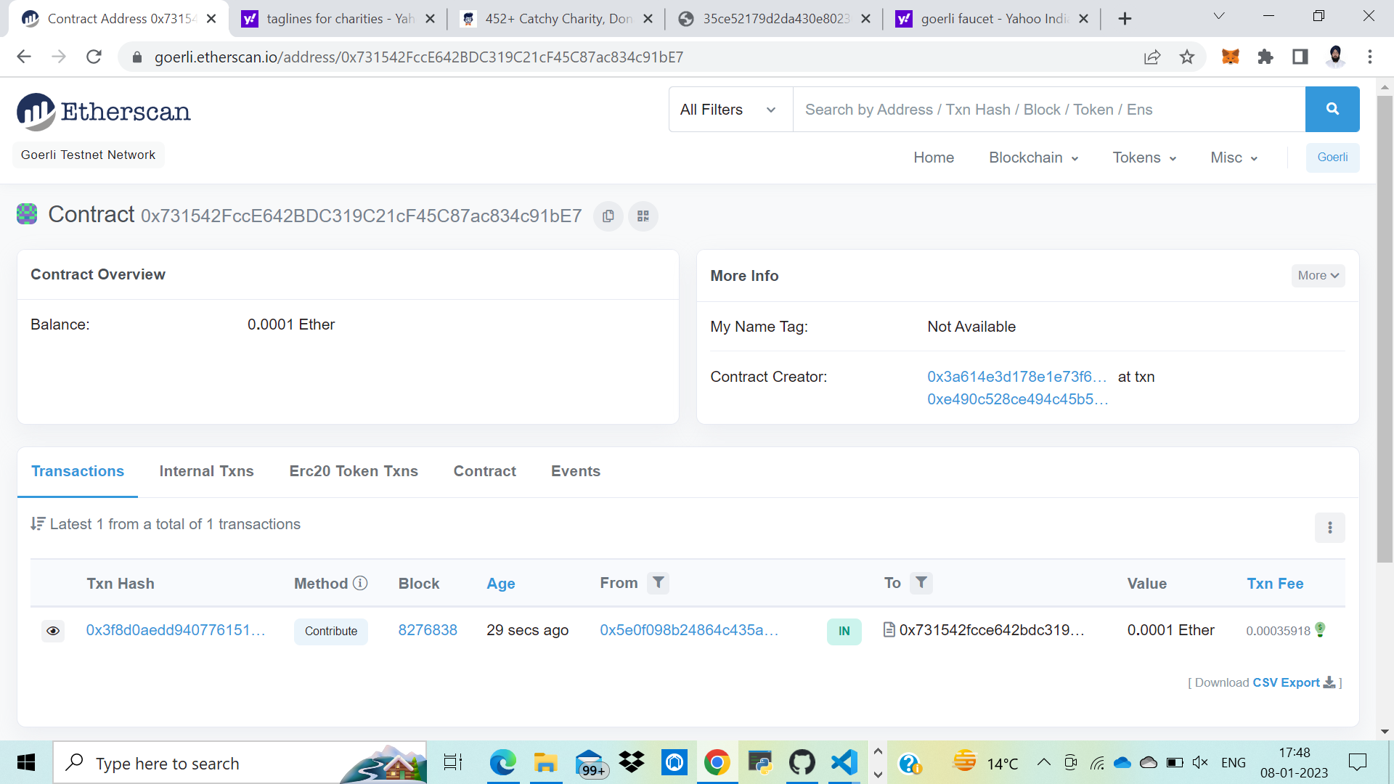
Contributing to a Campaign

Slide 25
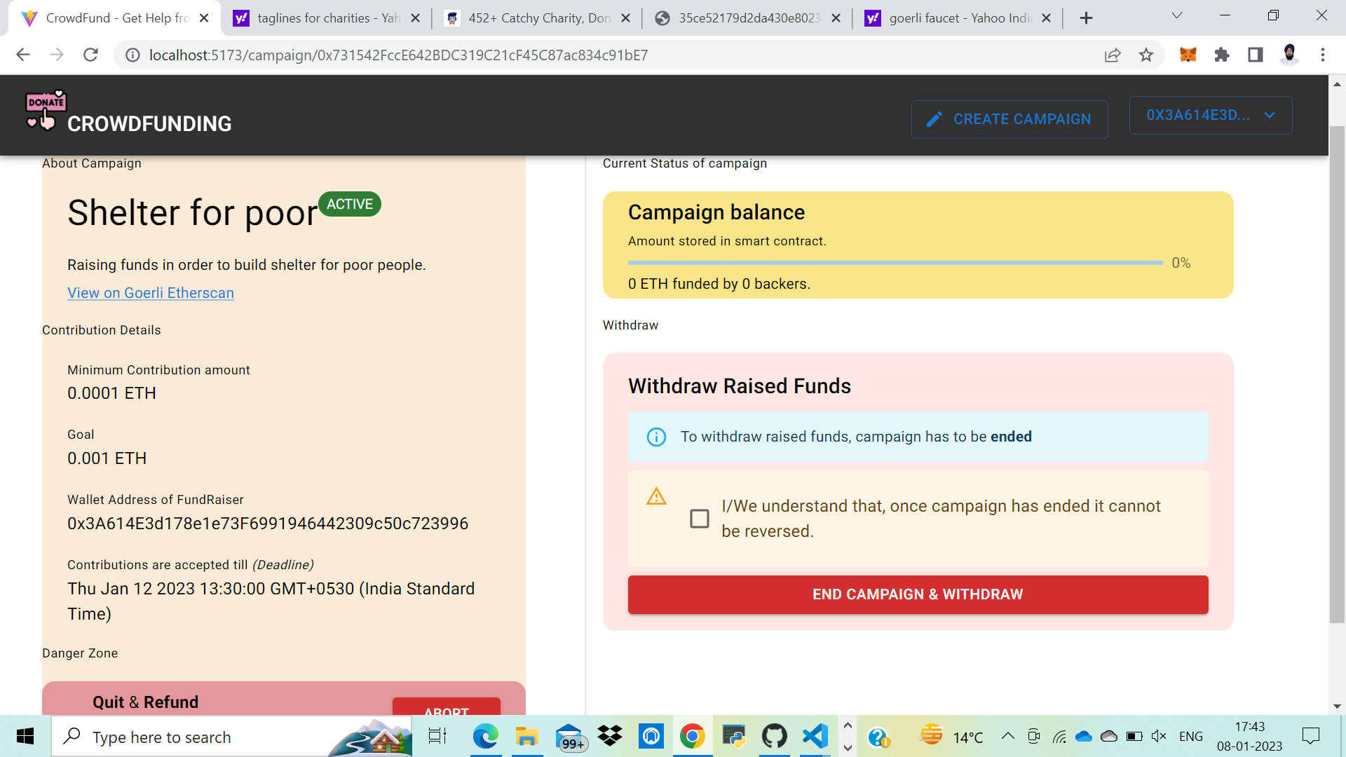
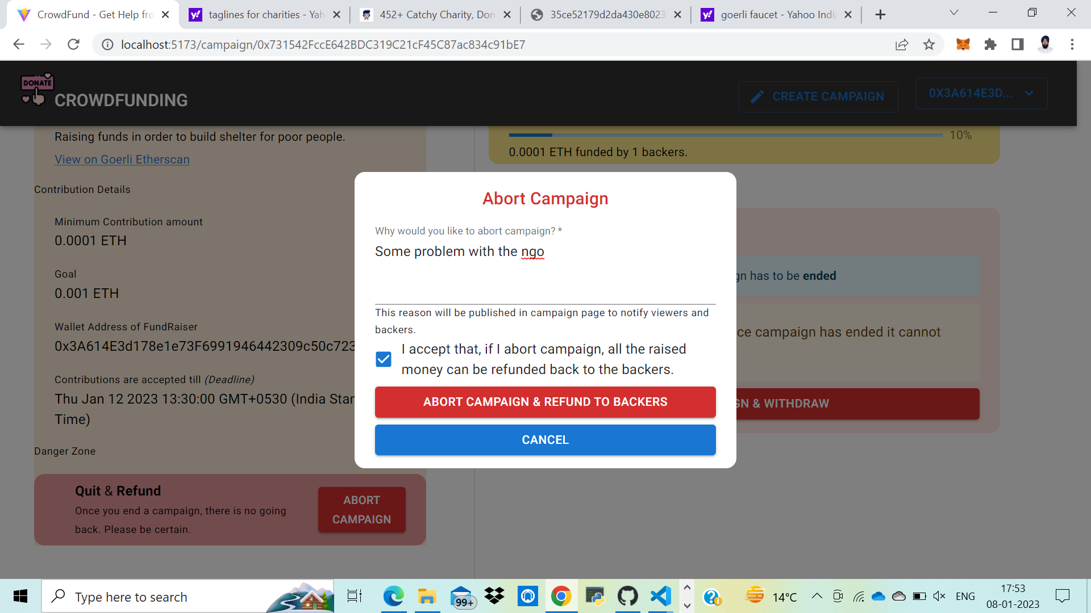
Making Withdrawal

Slide 26
Conclusion
Our Project, Crowdfunding Platform powered by Blockchain”, is complete, live and fully functional.
Conventional crowdfunding methods have long suffered from lack of transparency and fraud. It is an avoidable problem, and we believe that we have implemented a solid solution that can do away with these long-standing problems.
The aim to have a transparent, anti-fraudulent, decentralized platform has been achieved to a great extent. This project has covered the weak points of general crowdfunding platforms to provide transparency to the process of crowdfunding and build trust among people, so that they may contribute their wealth to good causes without fear of fraud.

Slide 27
References
Blockchain & Smart Contracts: https://www.dappuniversity.com/articles/how-to-build-a-blockchain-app
CryptoRelief platform: https://cryptorelief.in
Next JS Documentation: https://nextjs.org/
Learning Solidity Language: https://cryptozombies.io/
web3.js - Ethereum JavaScript API: https://web3js.readthedocs.io/en/v1.3.4/
How data is stored in Ethereum Blockchain: https://laurentsenta.com/articles/storage-and-dapps-on-ethereum-blockchain/
Metamask Ethereum Wallet : https://metamask.io/

Slide 28
Thank You

